Slide 1

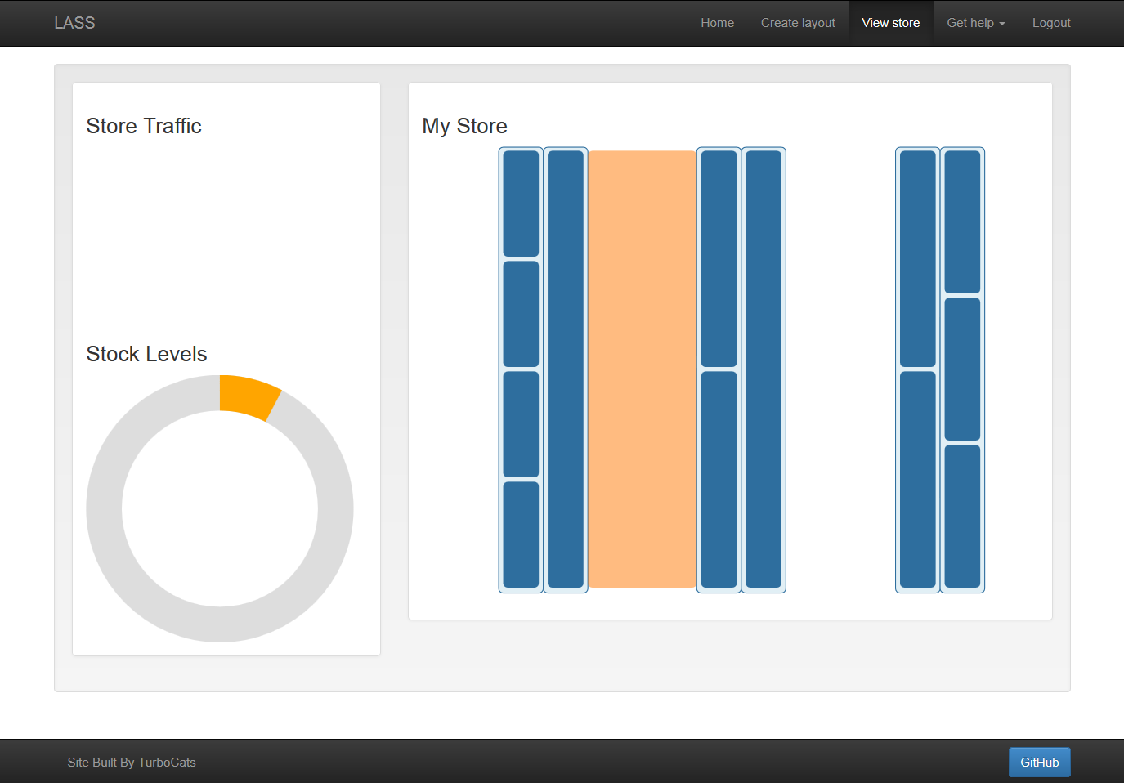

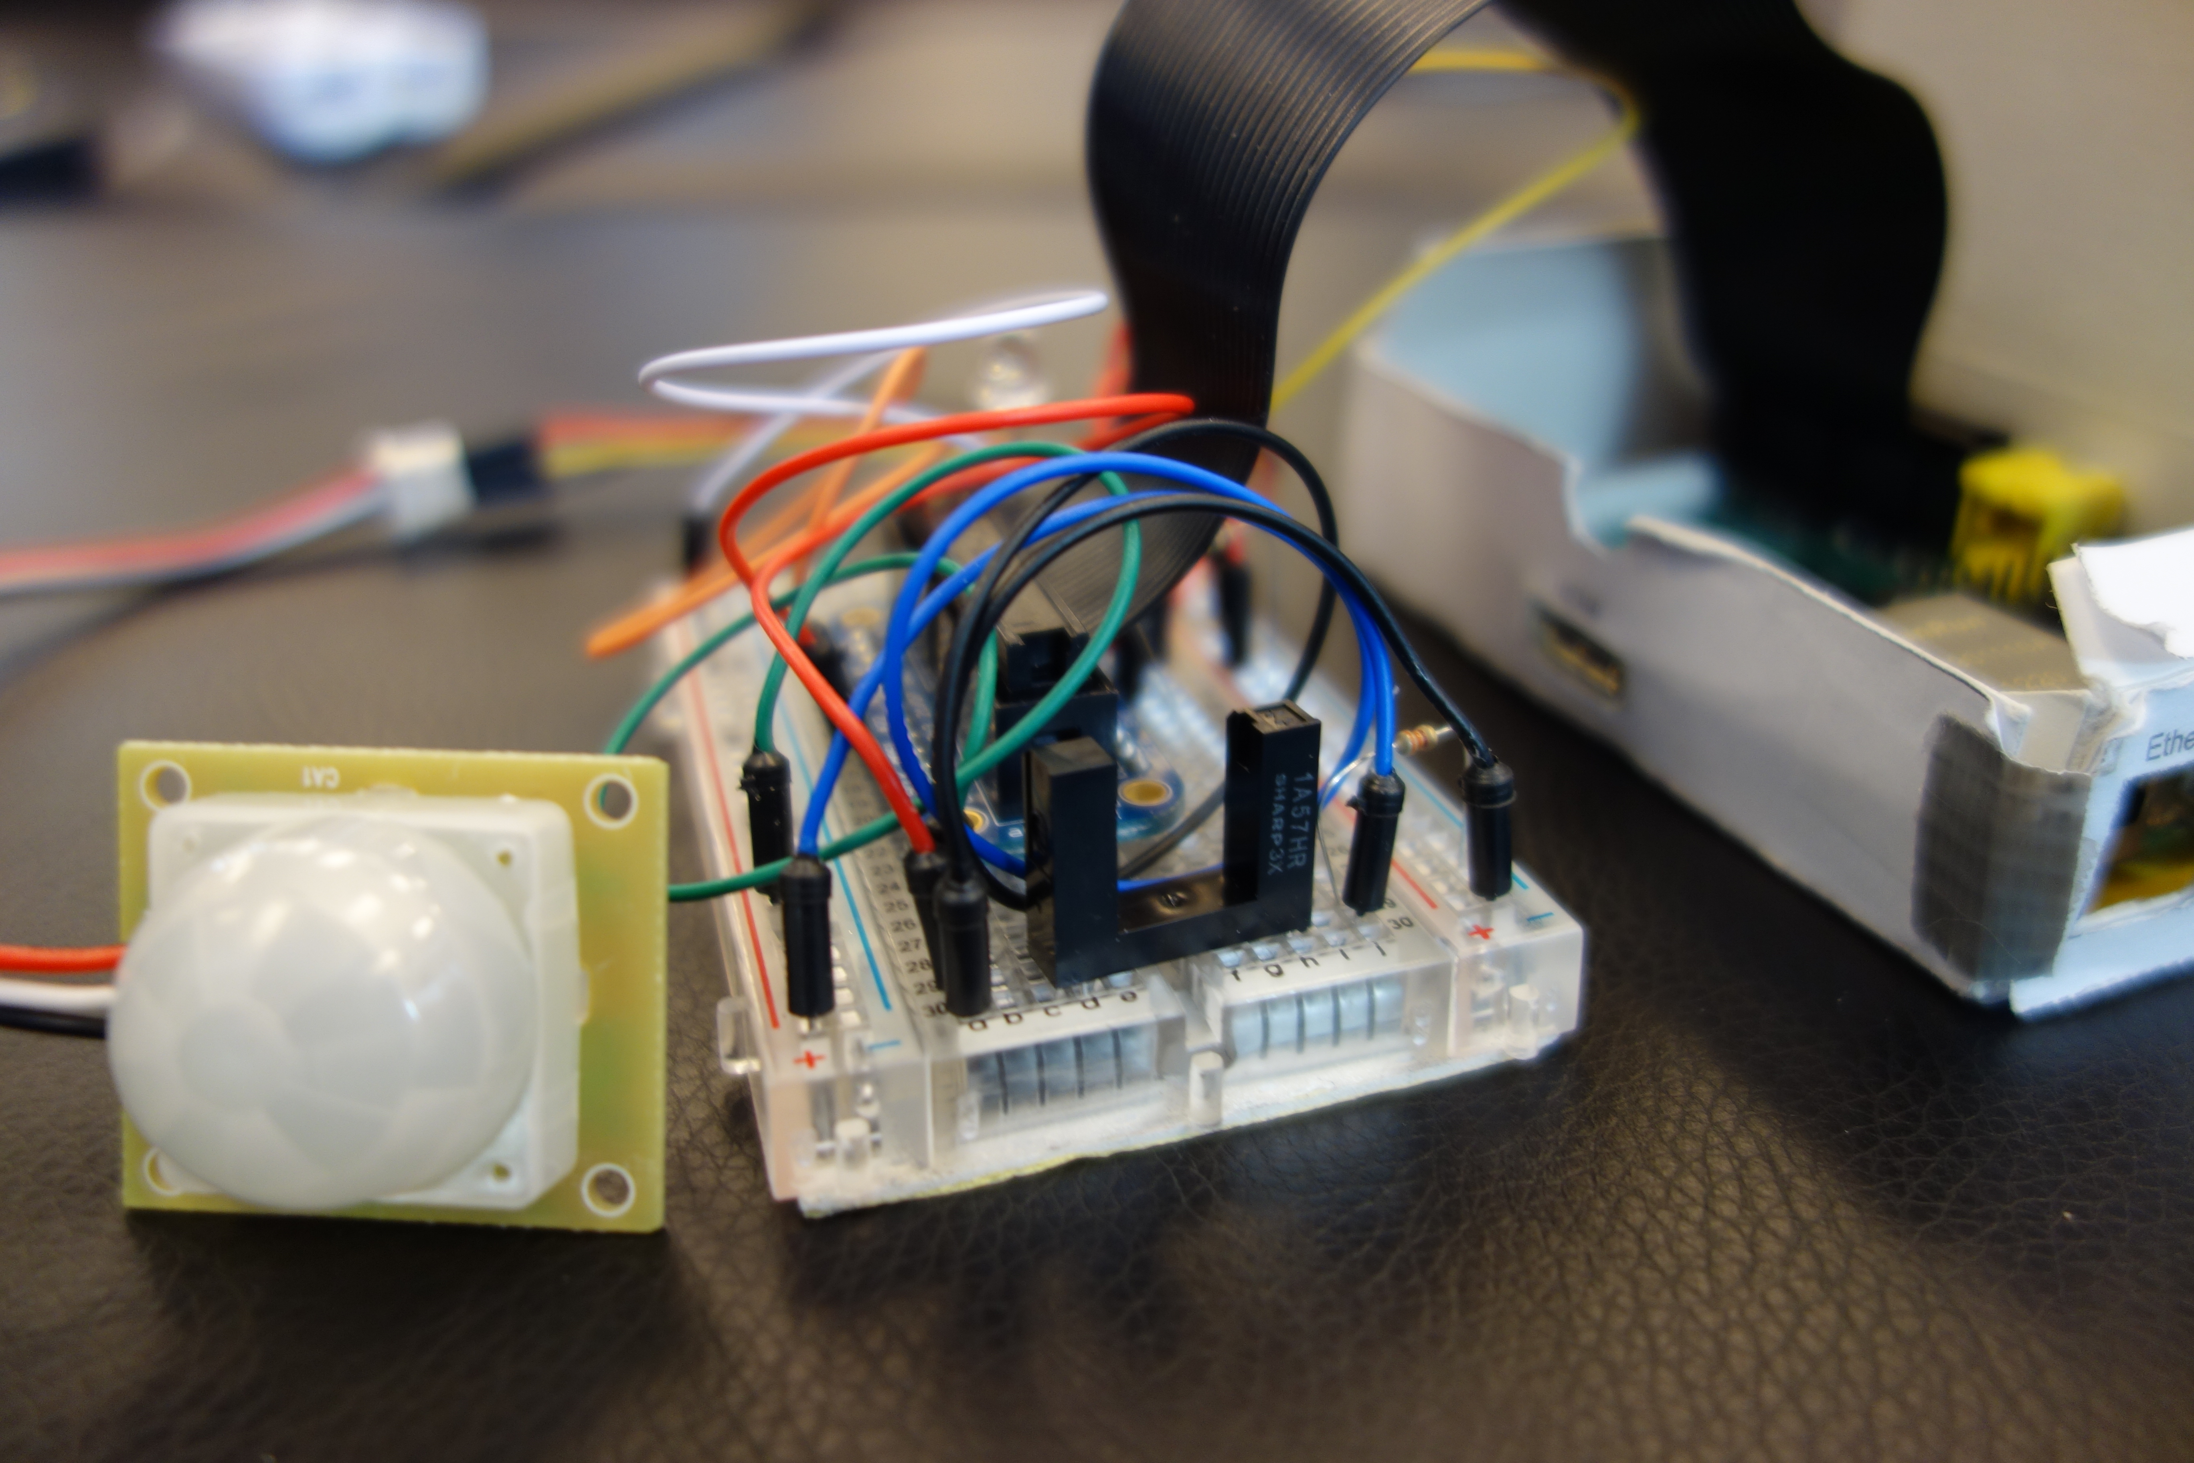

LASS: Location Aware Shelf System
Ben Trodd, Jeremy Steward, Harshini Nanduri, Alexandra Cummins and Kathleen Ang
Internet of Things (IoT) is a scenario in which objects, animals or people are provided with unique identifiers and the ability to automatically transfer data over a network without requiring human-to-human or human-to-computer interaction.
This project will be focused on developing a “smart shelf” that can track store traffic and shelf stock throughout the store.
The sensor / hardware component deals with the development of a prototype smart shelf that can update sensor readings to OGC SensorThings API.
The software/Web component allows a user to visualize data collected from the shelves.
One goal of this project is to serve as an example for developers looking to develop an IoT application using the OGC standard
Open Geospatial Consortium (OGC) is an international industry consortium of 472 companies, government agencies and universities participating in a consensus
process to develop publicly available interface standards.
This project will be developed as a Free, Open-Source Software (FOSS) and can be further hacked or improved upon for a variety of different applications

